Slide 1
Installation & Operations
420-E31 Systems III
References:
Dennis, Chapter 14
Rosenblatt, Systems Analysis and Design, 10th Ed
Satzinger, Systems Analysis and Design in a Changing World, 5th Ed
Hoffer, et al, Modern Systems Analysis and Design, 6th Ed
Notes:
Fresh breaking news from this summer:
http://www.chicagotribune.com/lifestyles/travel/ct-airline-computer-outages-what-to-know-20160816-story.html
http://bgr.com/2016/08/14/delta-finally-explained-how-one-power-outage-grounded-an-entire-airline/

Slide 2
And Now What?
You’ve designed, implemented and tested your system, hopefully in an iterative methodology.
It passes the acceptance tests, and you’re ready to make the system available for the users.
How do you do that?

Slide 3
Topics for Discussion
Moving from a test environment to a production environment
Handling data conversion
Putting the new system into operation – the system changeover plan
Training the users
Monitoring and Maintaining the system

Slide 4
Production and Test Environments
Production environment: environment for the actual system.
Also called the operational environment
Test environment: environment that programmers and testers use to develop and maintain system.

Slide 5
Production and Test Environments
Access to the production environment is limited to users and must be strictly controlled.
Programmers/Testers should not have access to the production environment except to upgrade it.
The test environment contains copies of all programs, procedures and test data files.
Before making any changes to the production system, you must verify them in the test environment.

Slide 6
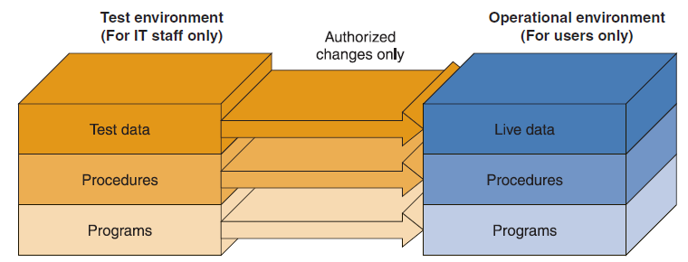
Test versus Production Environment

Slide 7
Problem statement
Test environments differ from Production environments
Tests that pass in a test environment may not be successful in a production environment
Production environments are expensive

Slide 8
Production Environment
Hardware servers
Application servers
Networking, firewalls
Software and OS versions
Services (Authentication, Authorization, Monitoring, Billing, email)
Notes:
Very expensive to have all the production environment to be the same
Process discipline in place to make sure the UAT and Production environment is as closely matched as is reasonable (re: risk vs cost)

Slide 9
Moving from the Test to the Production Environment
An effective testing process is essential. Even the smallest change to the production environment can cause problems.
After any code modification, the acceptance tests need to be run, before the system is deployed to production.

Slide 10
Development, Testing, Acceptance and Production
The program or component is developed on a Development system. This development environment might have no testing capabilities.
Once the developer thinks it is ready, the product is copied to a Test environment, to verify it works as expected. This test environment is supposedly standardized and in close alignment with the target environment.
If the test is successful, the product is copied to an Acceptance test environment. During the Acceptance test, the customer will test the product in this environment to verify whether it meets their expectations.
If the customer accepts the product, it is deployed to a Production environment, making it available to all users of the system.

Slide 11
Data Conversion
Data conversion is often necessary when deploying a system.
Typically the data conversion process is automated.
Data conversion is something you have to be continuously be aware of, after the first release of the system.
If you change a field in the database, you have to write database conversion code to convert the old data into the new format.

Slide 12
Migration Planning
What activities will be performed when and by whom
Technical aspects
Installing hardware and software
Converting data
Organizational aspects
Training users on the system
Motivating employees to use the new system to aid in their work

Slide 13
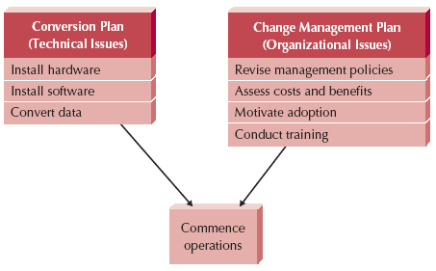
Elements of a Migration Plan

Slide 14
Conversion Styles
Direct conversion
The new system instantly replaces the old one.
Parallel conversion
For a time both old and new systems are used. The old is abandoned when the new is proven fully capable.

Slide 15
Conversion Location
Pilot conversion
One or more locations are converted to work out bugs before extending to other locations
Phased conversion
Locations are converted in sets
Simultaneous conversion
All locations are converted at the same time

Slide 16
Conversion Modules
Whole system conversion
All modules converted in one step
Modular conversion
When modules are loosely associated, they can be converted one at a time
Notes:
Whole system conversion: Aka “big bang”

Slide 17
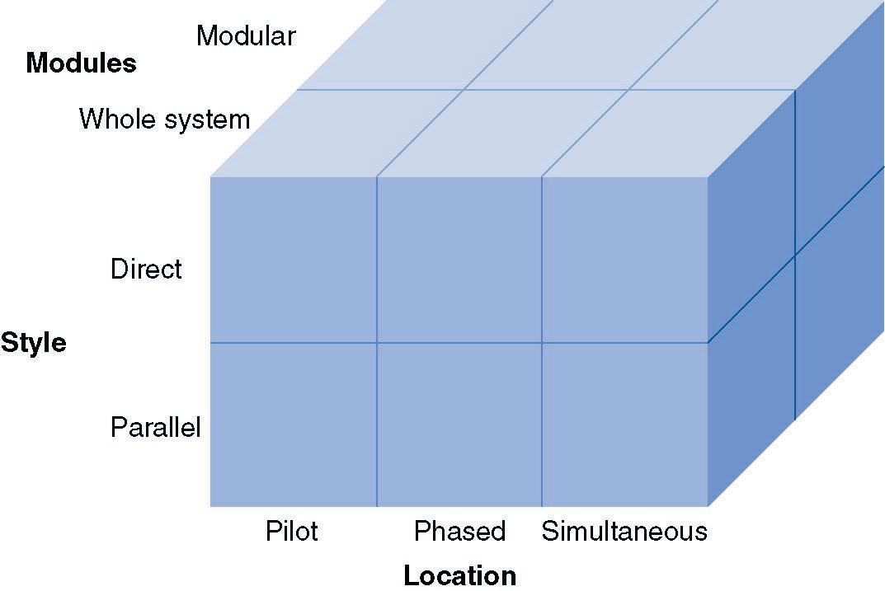
Conversion Strategies
Notes:
Pick a co-ordinate

Slide 18
Selecting a Conversion Strategy
Risk
Consequences of remaining bugs
Cost
Parallel requires paying for two systems for a period of time
Simultaneous requires more staff to support all locations
Time
Parallel, phased, modular require more time
Notes:
Pick any two because you cannot control all three

Slide 19
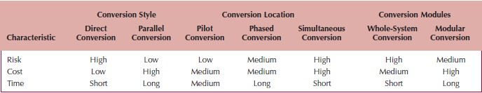
Characteristics of Conversion Strategies

Slide 20
Your Turn
Suppose you are leading the conversion from one word processor to another at the college.
Which conversion strategy would you use?
Suppose you are converting to a new web-based course registration system.
Which conversion strategy would you use?
Suppose you are installing an HR system for the first time.
Which conversion strategy would you use?

Slide 21
Change Management
Change management is the process of helping people to adopt and adapt to the to-be system and its accompanying work processes.

Slide 22
Key Roles in Change Management
The sponsor is the business person who initiated the request for the new system
The change agent is the person(s) who lead the change effort
The potential adopter(s) are the people who must change

Slide 23
Change Management Actors
Sponsor | Change Agent | Adopters (Users)
Wants the change to occur | Leads the change effort | People whose job must change 20-30% - ready 20-30% - resistant 40-60% - reluctant

Slide 24
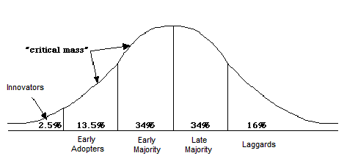
Adopter Scale

Slide 25
Understanding Resistance to Change
What is good for the organization, is not necessarily good for the individuals who work there
Cost versus benefit of transition as well as of to-be system
Adapting to new work processes requires effort, for which there may be no additional compensation

Slide 26
Training
Every new system requires new skills
New skills may involve use of the technology itself
New skills may be needed to handle the changed business processes

Slide 27
What to Train
Should focus on helping users accomplish their tasks
Use cases provide an outline for common activities and a basis to plan training
Types of training:
One-to-one
Classroom
Computer-based

Slide 28
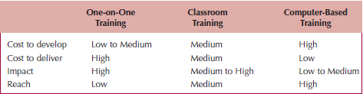
Selecting a Training Method

Slide 29
Post-implementation Activities
Post-implementation activities include providing:
System support, such as help desks
Systems maintenance, fixing bugs and providing improvements
Project assessment, learning how to improve from project experiences

Slide 30
Support vs. Operations
Systems support
The on-going technical support for users, as well as the maintenance required to fix any errors, omissions, or new requirements that may arise
Systems operation
The day-to-day operation of an information system’s business processes and application programs
Notes:
An operational system is a system that system that has been placed into operation.
Often called a production system
Operations – proactive
Support – reactive

Slide 31
Types of System Support
On-demand training at time of user need
Online support
Frequently asked questions (FAQ)
Help desk
Phone service for known issues
Level 2 Support
Application Support
Level 3 Support

Slide 32
Support Activities
Program Maintenance
corrects “bugs” that slipped through development process.
System Recovery
restoration of system & data after a system failure
Technical Support
any assistance provided to users in response to inexperience or unanticipated situations.
System Enhancement
improvement of system to handle new business problems, new technical problems, or new technology requirements

Slide 33
System Maintenance
System maintenance is the process of refining the system to make sure it continues to meet business needs

Slide 34
Maintenance Activities
To correct errors.
To preserve those aspects of the programs that were correct and to avoid “ripple effects” of changes that may adversely affect the correctly functioning aspects.
To avoid the degradation of system performance.
To complete the task as quickly as possible without sacrificing quality and reliability of system

